Slide 1


Hope to Skills
Lecture# 15
Irfan Malik, Dr. Sheraz Naseer

Slide 2
Agenda
Data Science
Data Science processes
Types of Data

Slide 3
Previous lecture:
Lecture 14 - Hugging Face 02
Click Here
Lecture 14 : Quiz 04
https://shorturl.at/eCDO4

Slide 4
Data Science

Slide 5
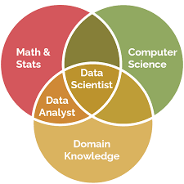
Data Science
Data science is the field of extracting knowledge and insights from data through a blend of statistics, programming, machine learning, and domain expertise.

Slide 6
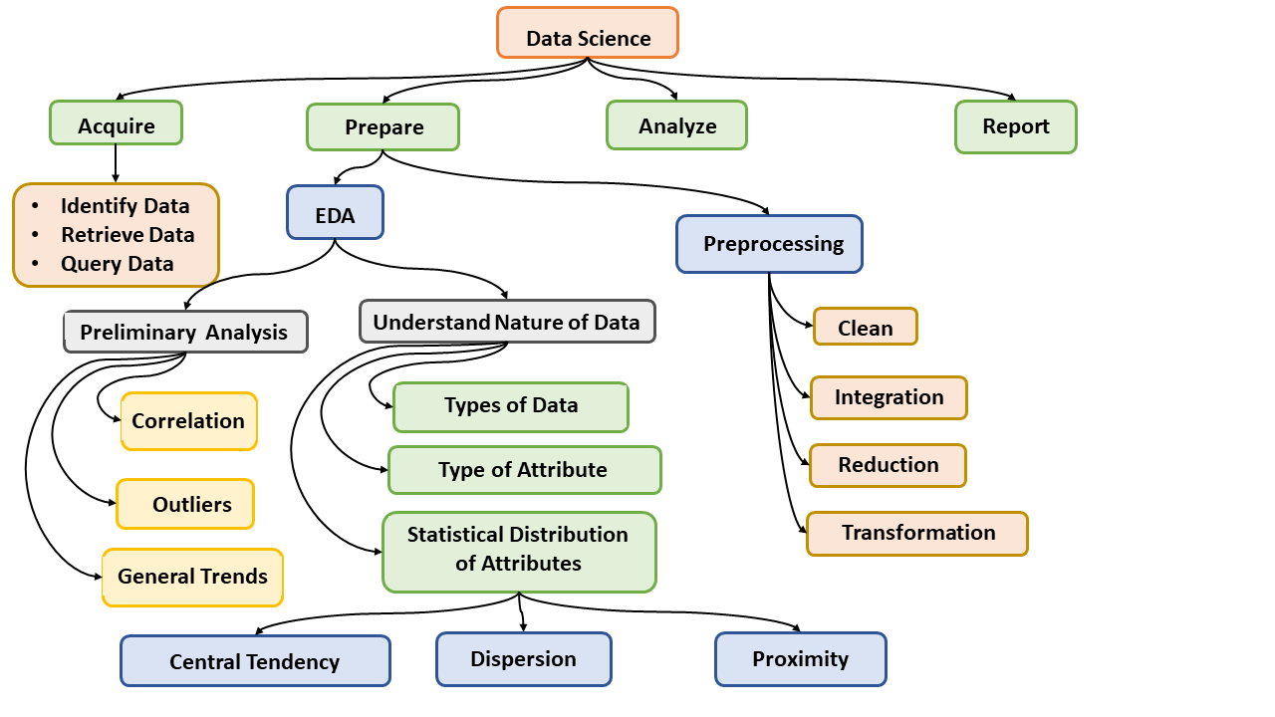
Data Science Processes

Slide 7
Types of Data
Types of Attribute

Slide 8
Structured Data
Structured data is organized and follows a predefined format, usually stored in databases or spreadsheets.
Example: A customer database with columns for name, age, email, and purchase history.
Ordinal data
Nominal data
Numerical data

Slide 9
Structured Data Examples
Ordinal:
Movie ratings (1-5 stars)
T-shirt sizes (S, M, L)
School grades (A, B, C)
Nominal:
Blood types (A, B, AB, O)
Hair colors (blonde, brunette, redhead)
Favorite sports (soccer, basketball, tennis)
Numerical:
Ages (years)
Temperatures (°C)
Book page numbers
Bonus:
Traffic light colors (red, yellow, green) – nominal for each light, ordinal for sequence.

Slide 10
Unstructured Data
Unstructured data is not organized and lacks a predefined format, often in the form of text, images, audio, or video.
Example: Social media posts, customer reviews, or images from a surveillance camera.

Slide 11
Semi-Structured Data
Semi-structured data has some organization but does not adhere to a strict schema, often containing tags or labels.
Example: Emails, JSON files that contain data with tags or key-value pairs.

Slide 12
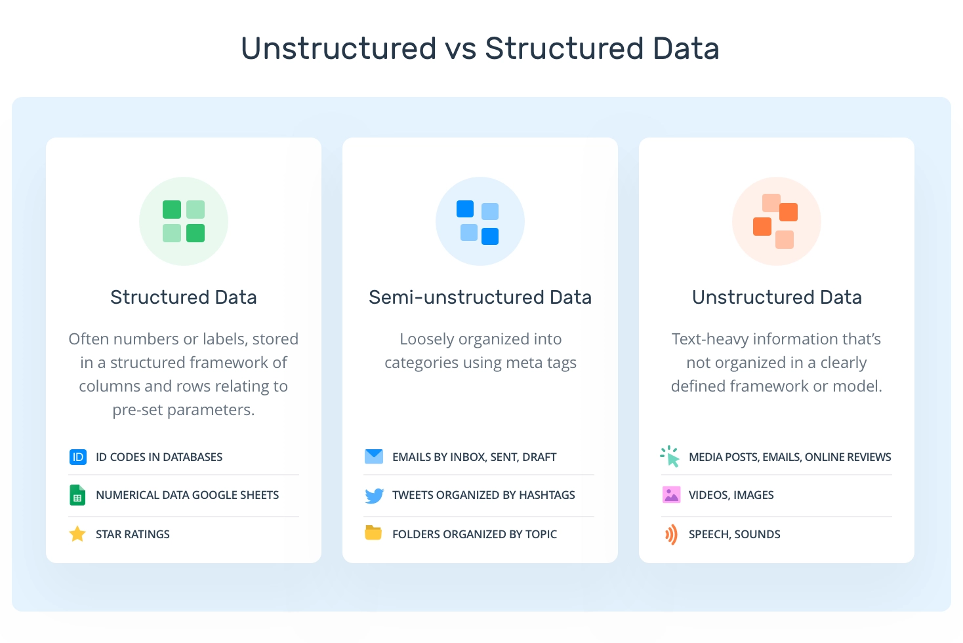

Slide 13
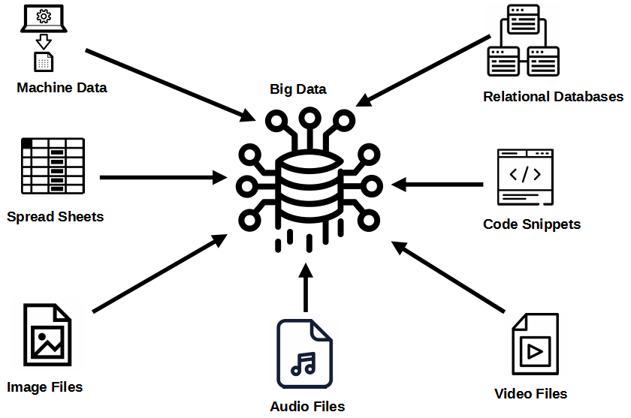
Data Acquisition
Data acquisition refers to the process of collecting raw data from various sources, which could be structured or unstructured, to be used for analysis, modeling, or other purposes.
Identify Data
Retrieve Data
Query Data

Slide 14

What is Exploratory Data Analysis (EDA)?
The process of exploring and summarizing the main characteristics of the data to uncover patterns, relationships, and trends.
It helps in formulating questions and making data-driven decisions.

Slide 15
Importance of EDA:
Provides an initial understanding of the dataset.
Helps in identifying data quality issues, such as missing values, outliers, and inconsistencies.
Guides the selection of appropriate statistical techniques and models.
Helps in feature engineering and variable selection.
Enables the discovery of meaningful insights and actionable conclusions.

Slide 16
Descriptive Statistics
Descriptive statistics is the branch of statistics that focuses on summarizing and describing the main features/Attributes/Variables of a dataset.

Slide 17
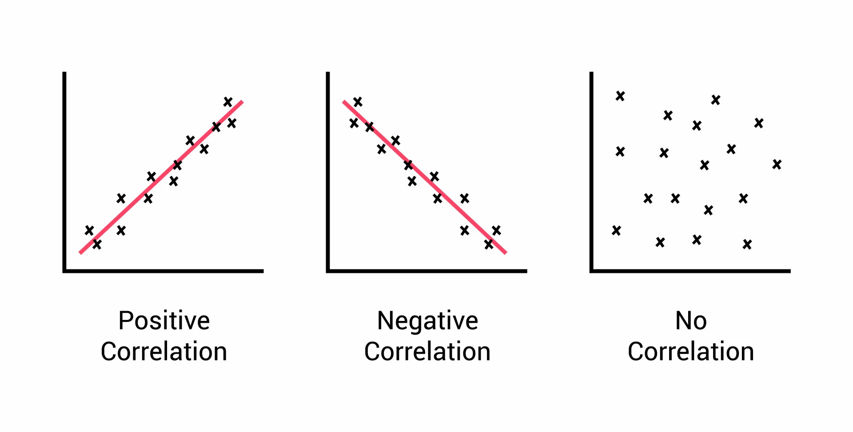
Correlation Analysis
Correlation analysis is used to determine the relationship between two or more variables in a dataset. It helps us understand how changes in one variable affect another variable.

Slide 18
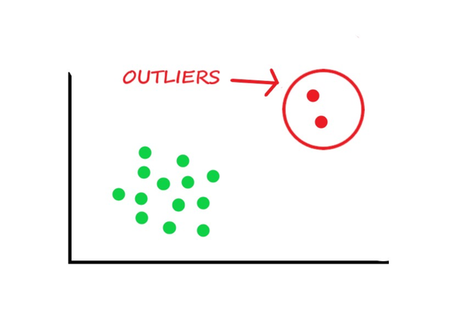
Outliers

Slide 19
Central Tendency
A measure of central tendency is a single value that attempts to describe a set of data by identifying the central position within that set of data. As such, measures of central tendency are sometimes called measures of central location.
The mean, median and mode are all valid measures of central tendency, but under different conditions, some measures of central tendency become more appropriate to use than others.

Slide 20
Mean
The mean is the average of a set of numbers.
Calculated by summing all the numbers in the dataset and dividing by the total count.
Formula: Mean = (Sum of all numbers) / (Total count)
Example: For the dataset [5, 7, 10, 12, 15], the mean is (5 + 7 + 10 + 12 + 15) / 5 = 9.8.
Sensitive to outliers
Example: For the dataset [5, 7, 10, 12, 150], the mean is (5 + 7 + 10 + 12 + 150) / 5 = 36.8.

Slide 21
Median
The median is the middle value in a sorted dataset.
If the dataset has an odd number of values, the median is the middle number.
If the dataset has an even number of values, the median is the average of the two middle numbers.
Example 1: For the dataset [3, 5, 6, 8, 9], the median is 6.
Example 2: For the dataset [2, 4, 6, 8], the median is (4 + 6) / 2 = 5.

Slide 22
Mode
The mode is the value that appears most frequently in a dataset.
A dataset can have one mode, more than one mode (multimodal), or no mode (no value repeats).
Example 1: For the dataset [3, 4, 4, 6, 8], the mode is 4.
Example 2: For the dataset [1, 2, 3, 4, 5], there is no mode.

Slide 23
Quartiles and Interquartile Range (IQR)
Quartiles:Before understanding the IQR, we need to grasp the concept of quartiles.
Quartiles divide a dataset into four equal parts, each representing a quarter (25%) of the data.
The first quartile (Q1) is the value below which 25% of the data falls.
The second quartile (Q2) is the value below which 50% of the data falls. It's actually Median.
The third quartile (Q3) is the value below which 75% of the data falls.

Slide 24
Finding Quartiles
To find the quartiles, first, arrange the dataset in ascending order.
If the dataset has an odd number of values, the median is the second quartile (Q2).
If the dataset has an even number of values, calculate the median of the lower and upper halves to find Q2.

Slide 25
Interquartile Range (IQR):
The IQR represents the difference between the first and third quartiles(Q1 and Q3).
It indicates the spread of the middle 50% of the data.
Formula: IQR = Q3 - Q1

Slide 26
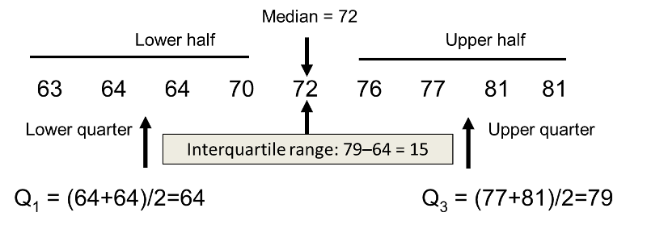
Interquartile Range (IQR):

Slide 27
Interpretation of the IQR
The IQR provides information about the spread and variability of the data.
A larger IQR indicates a greater spread and more variability in the dataset.
Conversely, a smaller IQR suggests a less spread and less variability.

Slide 28
Applications
The IQR is widely used in various fields, including economics, healthcare, and social sciences.
It helps compare and analyze data distributions, identify abnormal data points, and detect potential patterns or trends.

Slide 29
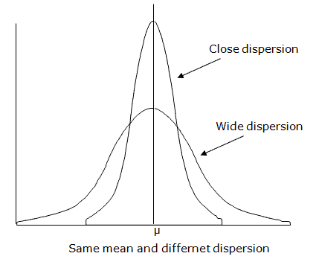
Why we care about Dispersion?
Dispersion is the spread of data points around a central value, indicating variability within a dataset.
Increased difficulty in capturing patterns.
Increased risk of overfitting.
Reduced predictive accuracy.
Impact on outlier handling

Slide 30
Proximity:
In machine learning, "proximity" refers to the measure of similarity or closeness between data points within a dataset. It is often used in clustering algorithms and nearest neighbor methods to determine how closely related or similar two data points are to each other based on certain features or attributes.

Slide 31
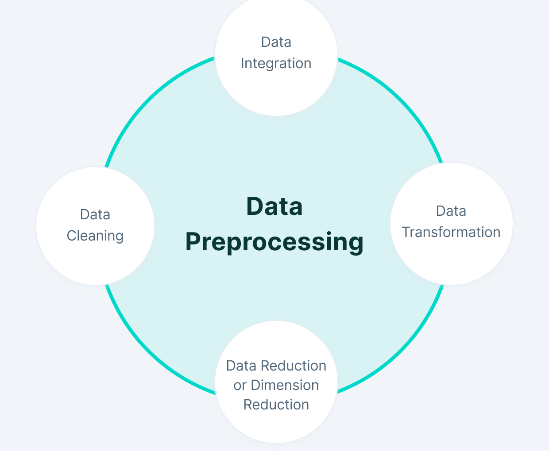
Data Preprocessing
Steps:

Slide 32
Data Cleaning Techniques
Handling Missing Data: We use methods like filling or removing to deal with missing values.
Outlier Detection: Find and address unusual data that can affect analysis or models.
Data Standardization: Make data consistent for easier analysis and comparison.
Data Validation: Check data against rules to ensure accuracy and reliability.

Slide 33
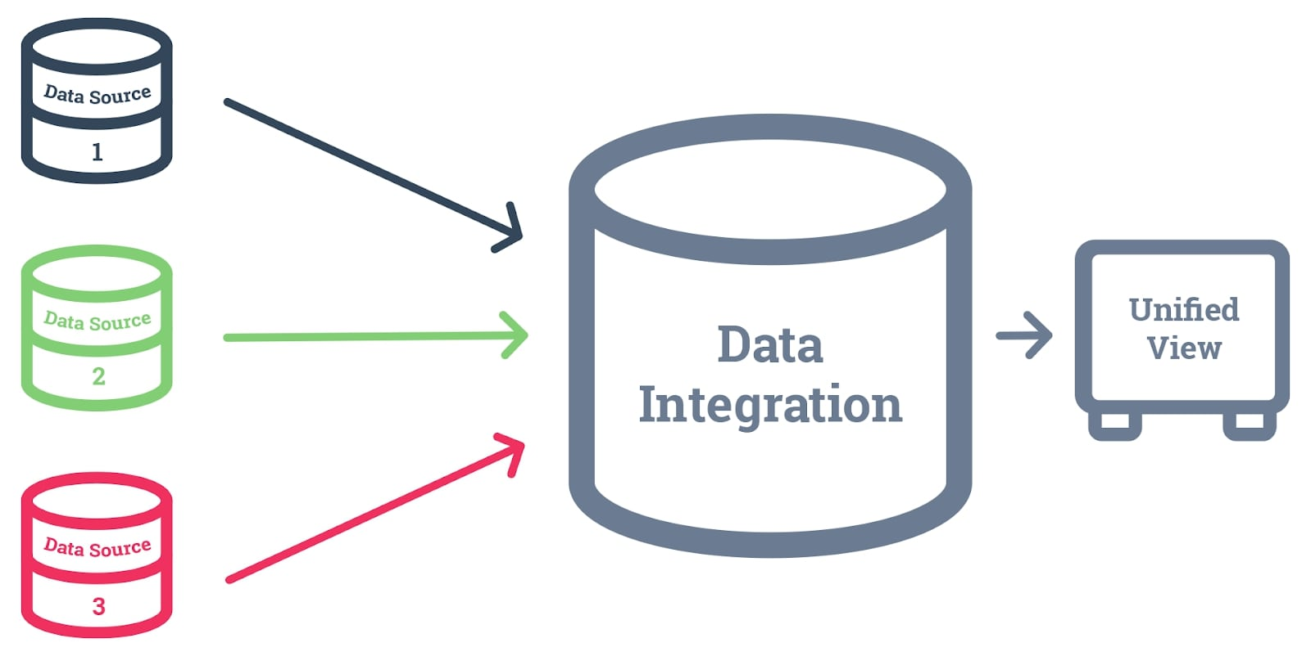
Data Integration
Data integration is the process of combining data from various sources into a single dataset. The goal is to provide users with consistent access to data across different subjects and structure types.

Slide 34
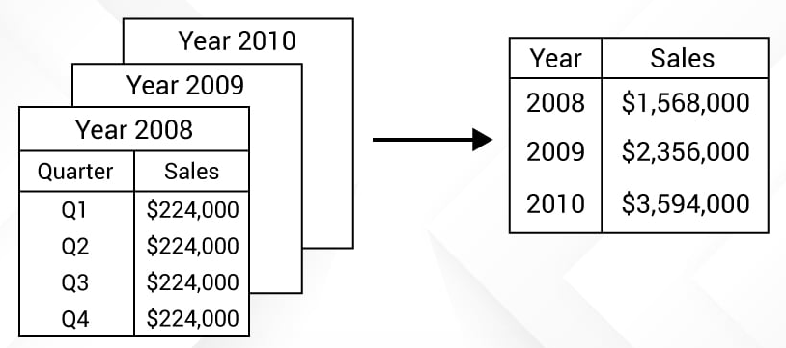
Data Reduction
Data reduction is the process of transforming digital information into a simplified, ordered, and corrected form. It can be used on numerical or alphabetical information.

Slide 35
PCA
Principal component analysis (PCA) is a statistical method that reduces a data table to its main features. It's a dimensionality reduction technique that's often used to reduce the size of large data sets. PCA works by linearly transforming data onto a new coordinate system.
Dimensionality Reduction Technique:
Eigenvalue Decomposition (Eigendecomposition):
Singular Value Decomposition (SVD):
t-SNE (t-Distributed Stochastic Neighbor Embedding)

Slide 36
Next Lecture:
Lecture 16 - Data Science Processes
Click Here

